Slide 1
NCP and phytoplankton dynamics

Slide 2
Overview
O2:Ar EIMS and MIMS
Spatial vs. time and space (Langrangian cycles) O2/Ar data
Profiles
Further data analysis
FRRF / CCE-LTER….
Papers to be written

Slide 3
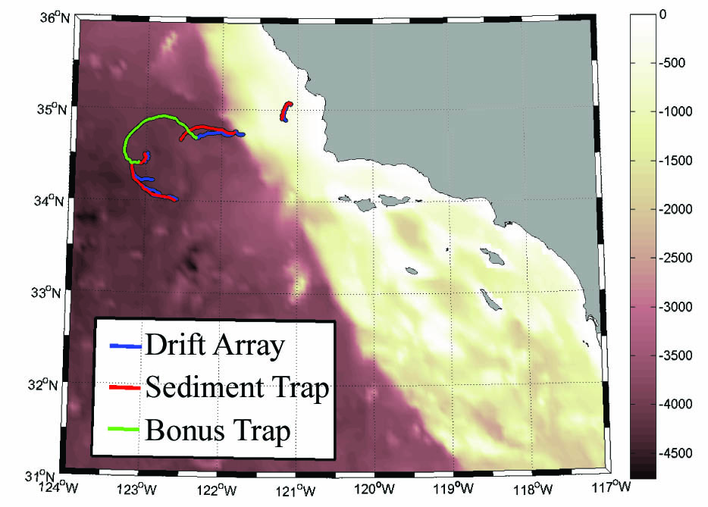
CCE-LTER P1706
DATA:
MIMS and EIMS O2/Ar
MIMS profiles
Ship data / CTD
2 SEASOAR transects- high spatial resolution MLD prior and after the stations
4 stations (2 with high productivity)
4 transects through filament
R-script to analyze the data – to be published!

Slide 5
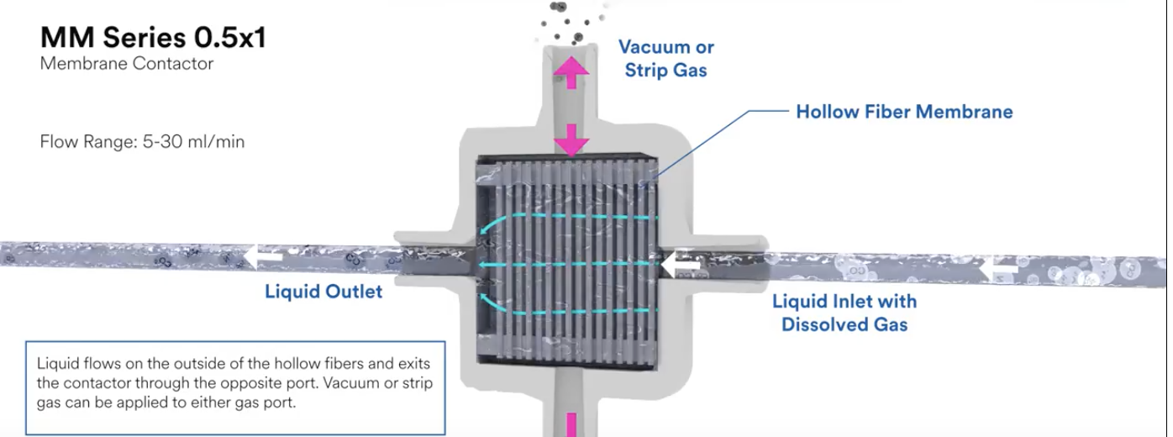
EIMS vs. MIMS
Vacuum – Gas inflow to MS
O2 optode
outflow
inflow
Membrane
Vacuum – Gas inflow to MS
Slow response time – averages sample over ~15min
Low drift, stable signal
Fast response time – averages sample over ~10 sec.
Signal drifts and is more temperature sensitive

Slide 6
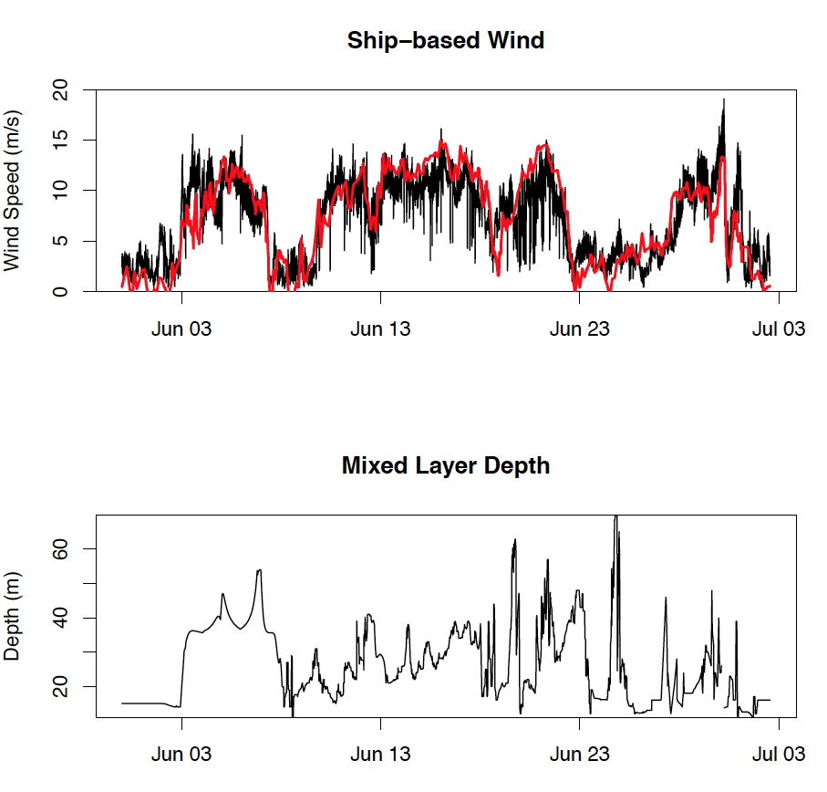
Wind - ship and NARR database
MLD from CTD profiles and seasoar

Slide 7
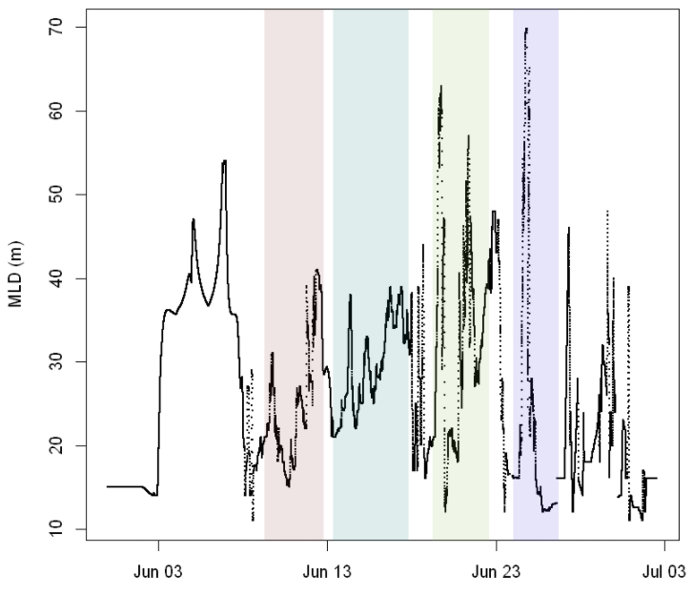
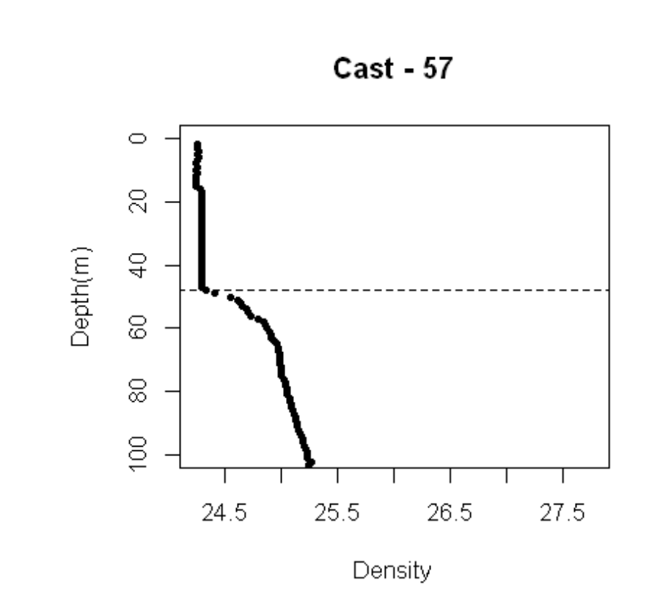
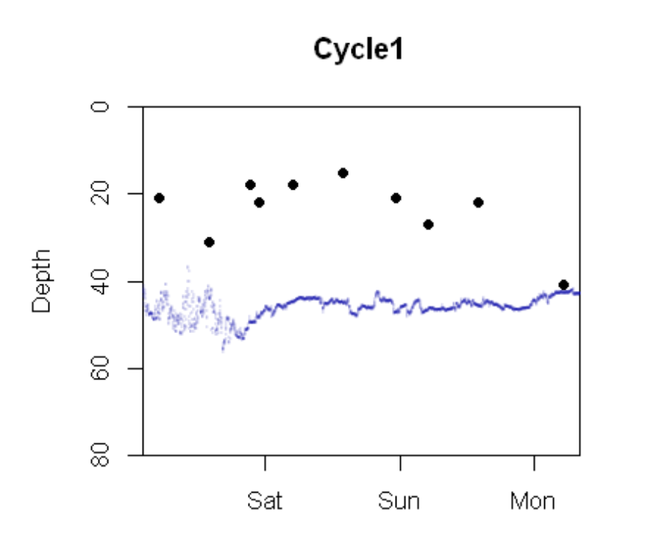
NCP parametrization
Wind data from NARR database!
Parameterization from Wanninkof 2014
k calculated as in Reuer 2007
MLD = from CTDs and seasoar estimated by ∆ρ= 0.1
O2/Ar from EIMS and MIMS
Shaded areas: cycle 1-4
MLD
Line: temp
Dots: MLD

Slide 8
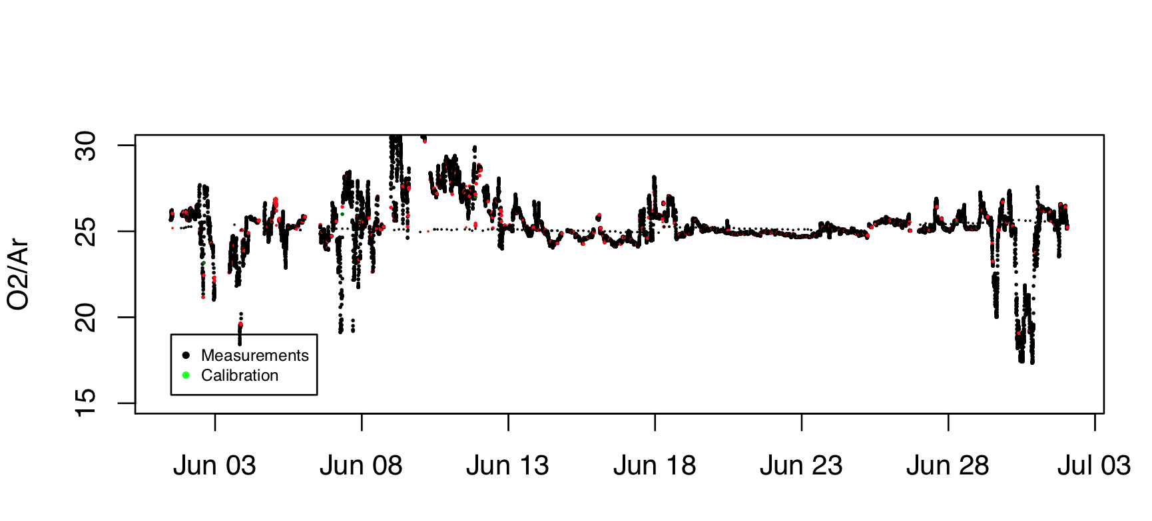
EIMS data
Red dots -outlier

Slide 9
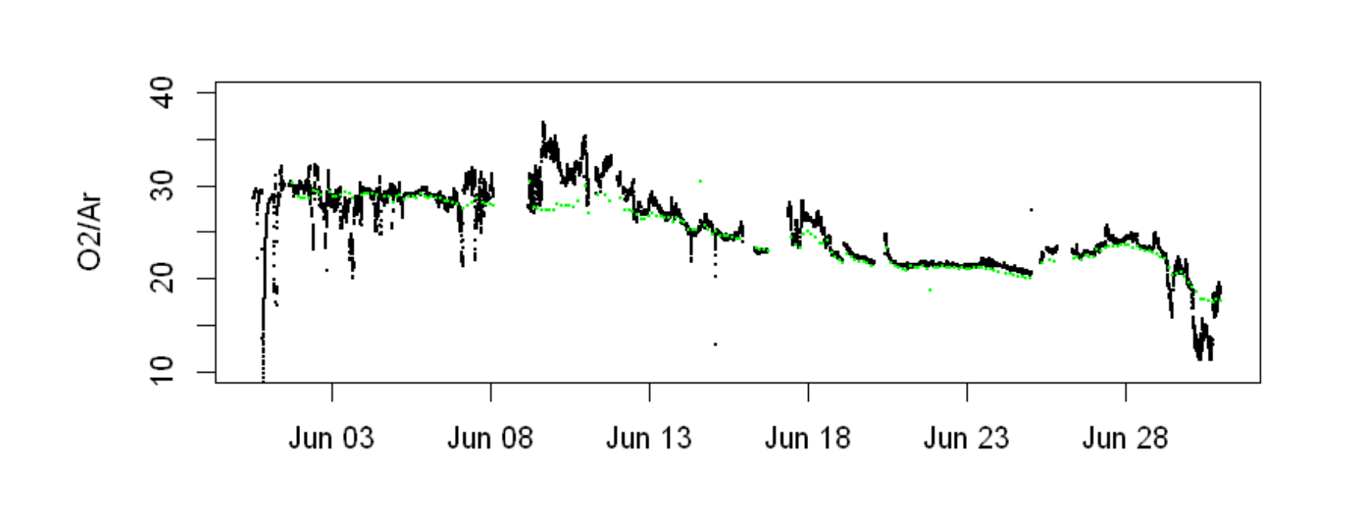
MIMS data
Green dots: calibration
Black dots: O2/Ar data

Slide 10
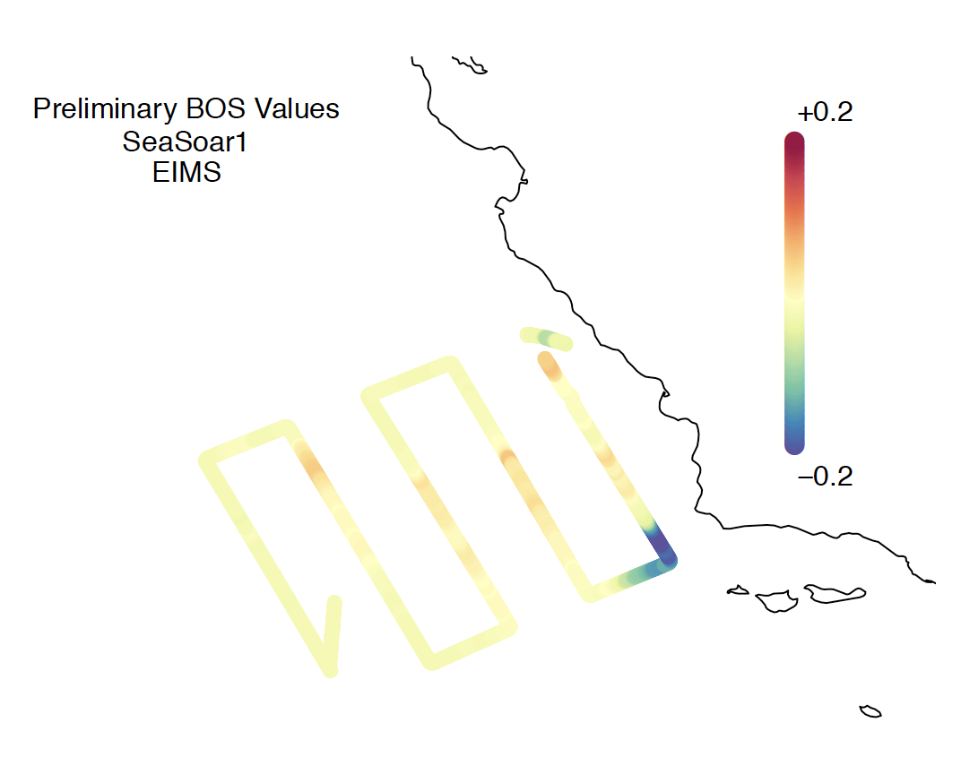
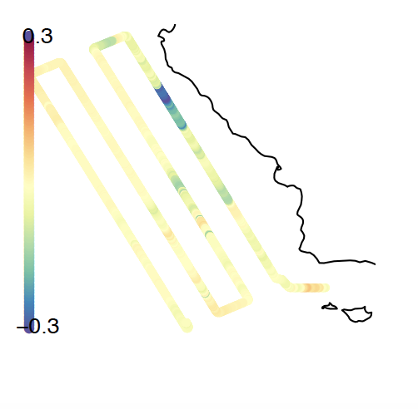
Data – spatial EIMS vs. MIMS – seasoar 1 or 2

Slide 11
Data – spatial EIMS vs. MIMS – cycle transects

Slide 12
Data – spatial EIMS vs. MIMS – seasoar 2

Slide 13
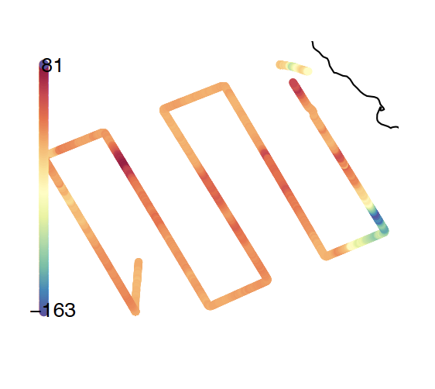
Impact of diurnal cycles on NCP analysis:
Diurnal NCP assumes that the O2 signal is an integrated signal covering past days (~7 days) (*k)- yet O2 concentratiuon can change over a diurnal cycle – hence diurnal changes influence O2/Ar analysis and only Lagrangian experiments can resolve this.
Use of cycle (1 and 2) as example (up to 4 days)
Use of high frequency FRRF GP data to potentially correct for the diurnal signal in the SEASOAR data!
Build model framework!

Slide 14
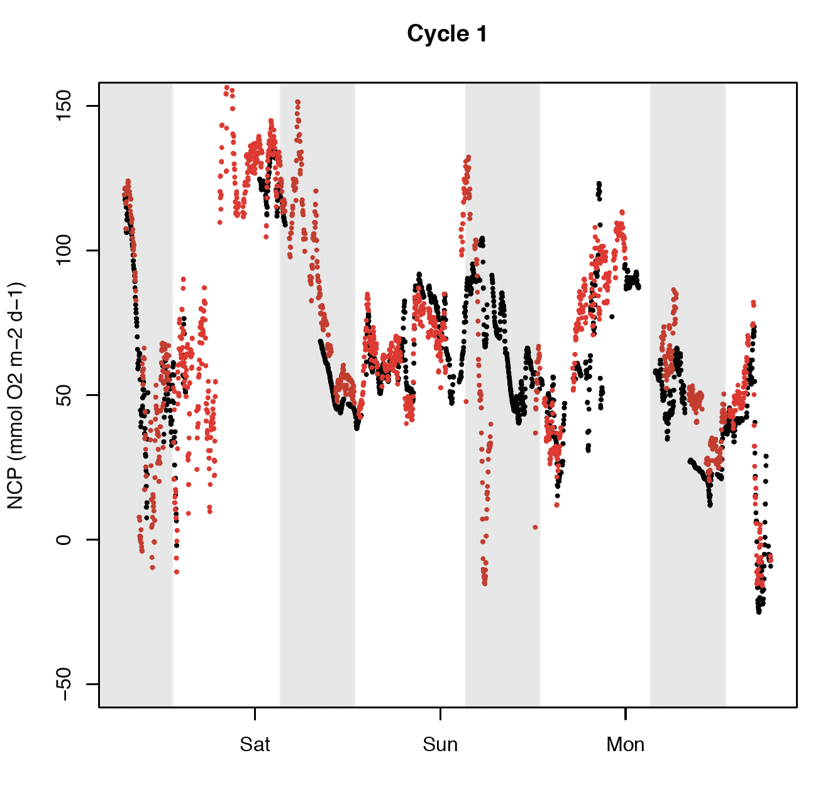
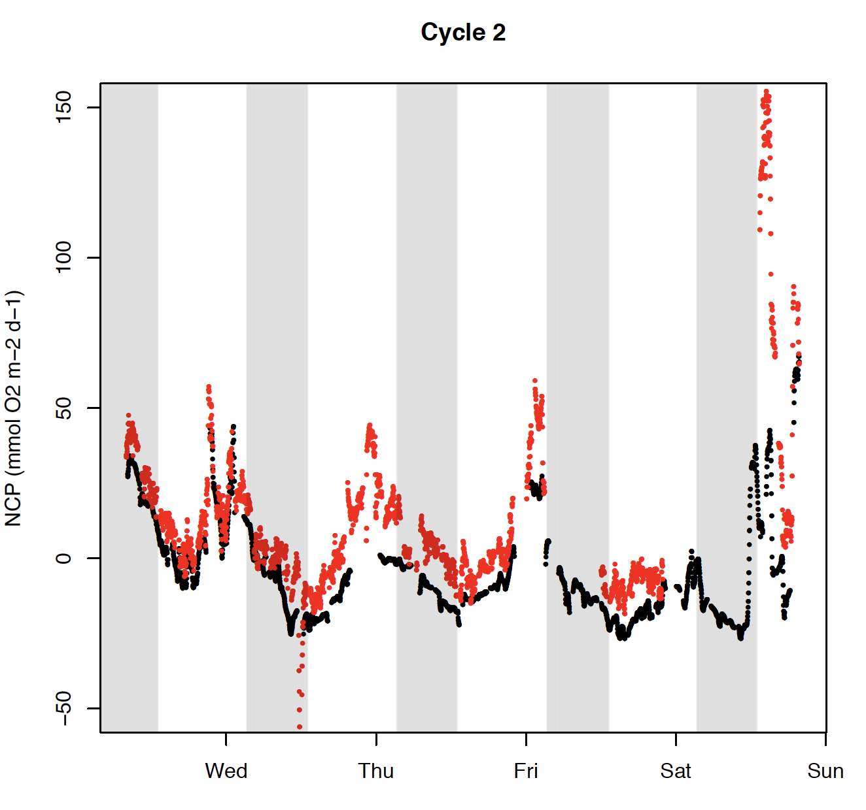
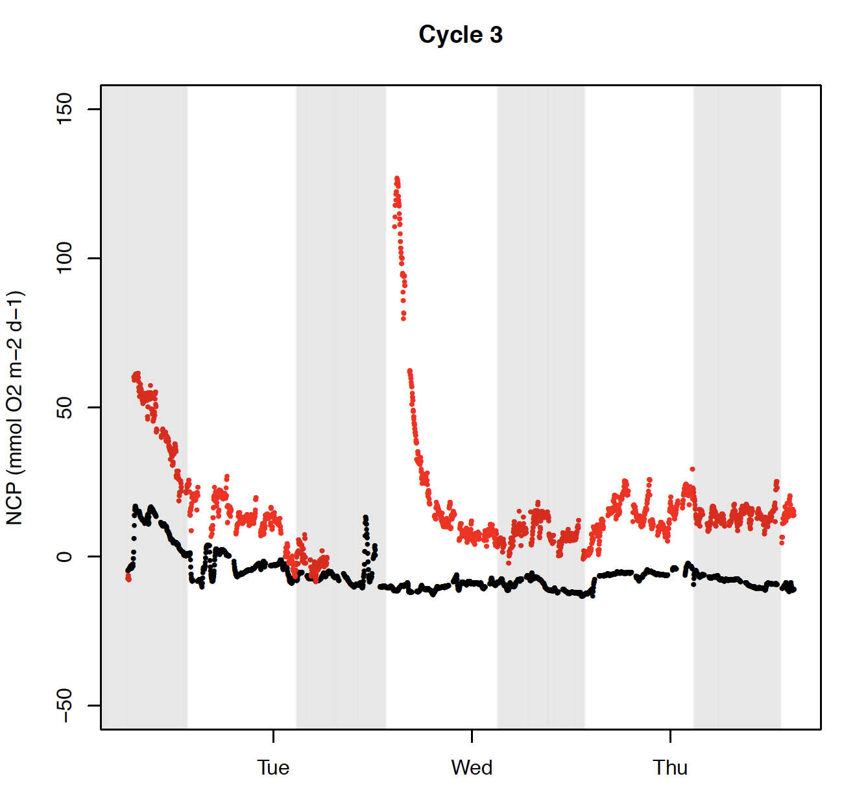
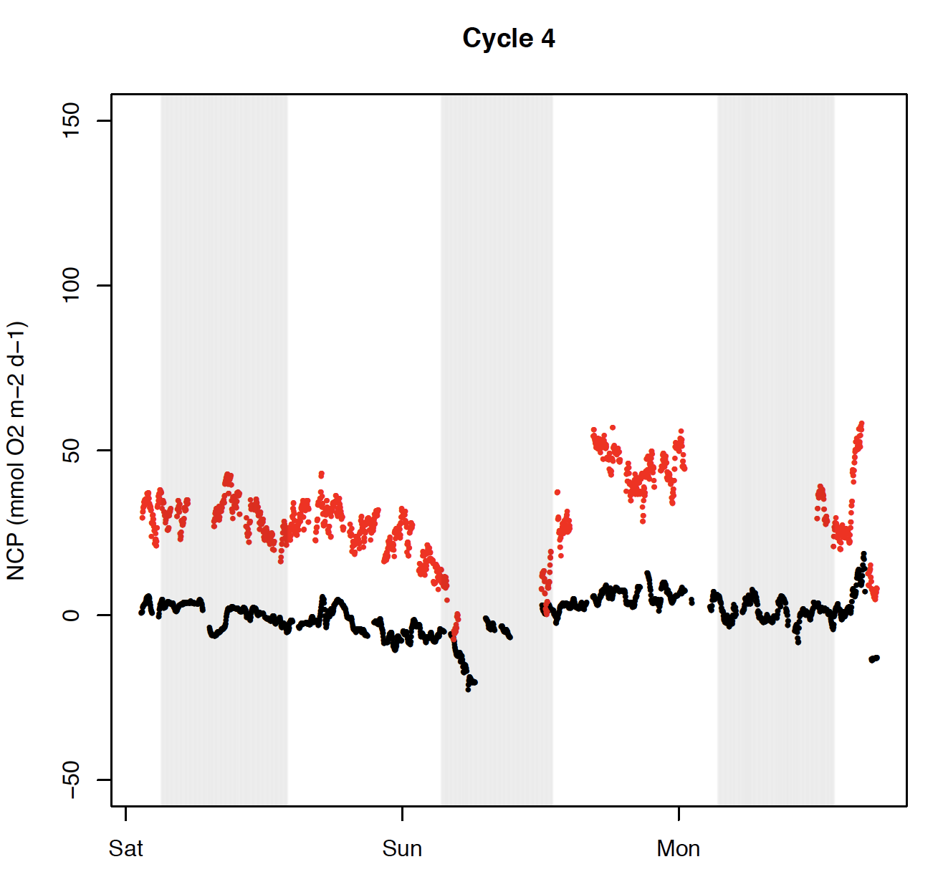
MIMS vs. EIMS NCP cycle 1-4
Deviation of NCP in cycles 3 and 4!!
Why?
Clear diurnal pattern in cycles 1 and 2

Slide 15
Example of strong diurnal periodicity!
3000
Par (uE)
Wind
(m/s)
Chl (mg/L)
Biological Oxygen Signal
For internal use only ;-)
Maybe add NO3
Maybe add GP from FRRF
RESIDENCE TIME OF O2?
Changes in wind?

Slide 16
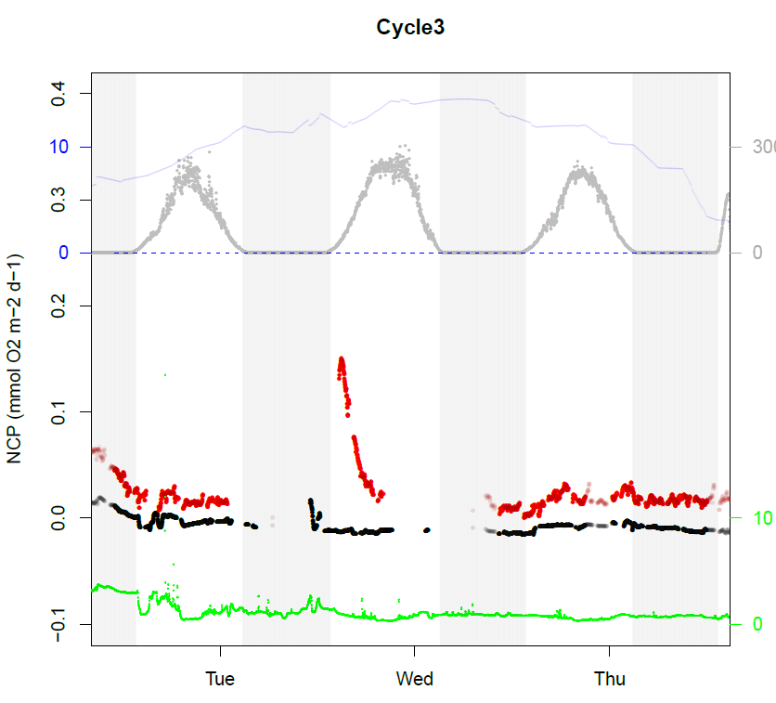
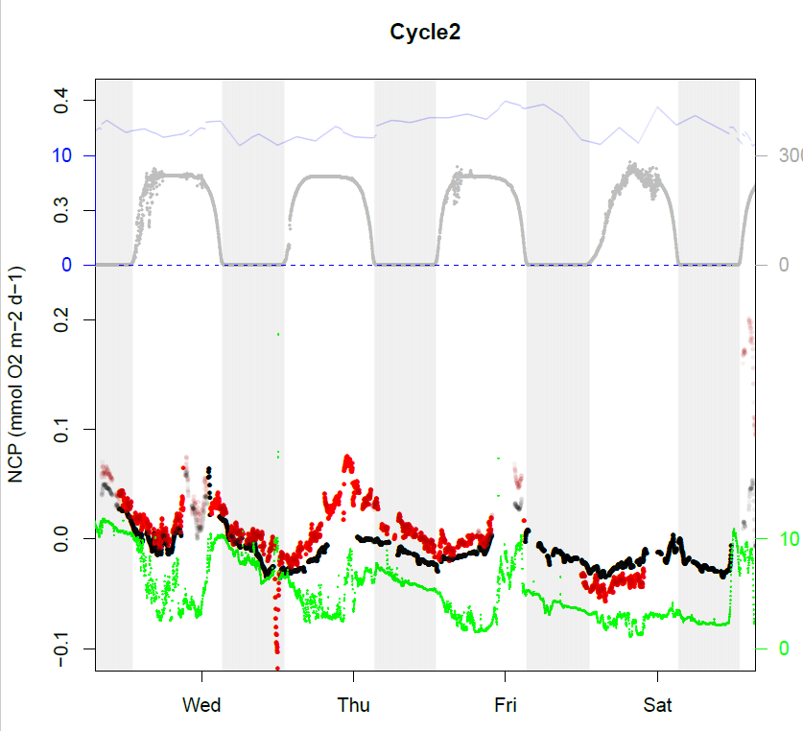
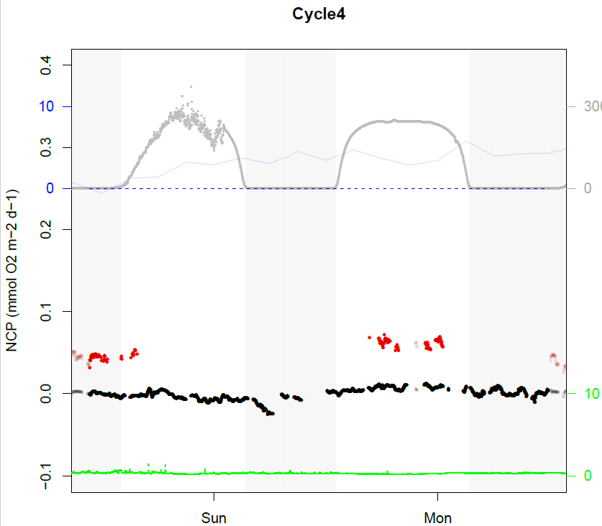
3000
Wind
(m/s)
Par (uE)
Biological Oxygen Signal
Biological Oxygen Signal
Chl (mg/L)
Biological Oxygen Signal
Biological Oxygen Signal

Slide 17
O2-Ar profiles

Slide 18
Data:
3 profiles to approx. 50m
Using a well pump and tubing connected to the MIMS/EIMS inlet
Profile @1m/min - upwards
Flow rate: approx 10L/min into the inlet system
Delay: approx 20 sec from intake to MIMS
Duration approx. 1h of measurement

Slide 19
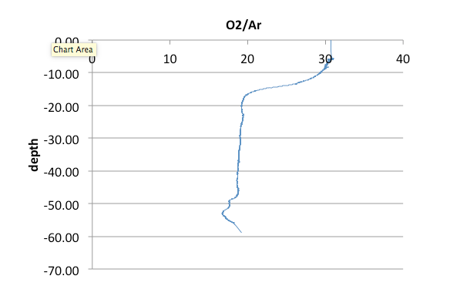
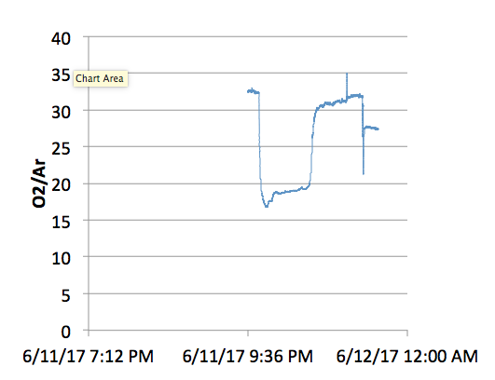
Profiles
Profile shown as O2/Ar vs. depth
Profile chronology
surface
52m
Depth O2/Ar profile uncorrected for pressure and temperature!
– do we have to?
- Ar and O2 both change over depth (temperature effect on membrane?)

Slide 20
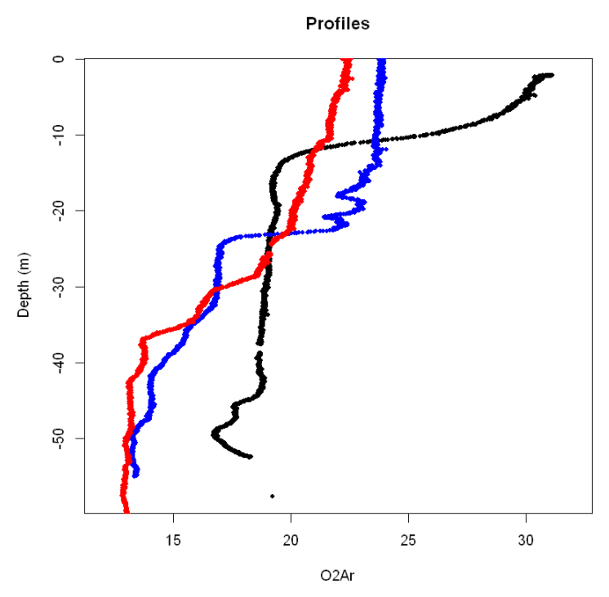
O2/Ar profiles
Cycle 3
Cycle 1
Cycle 2

Slide 21
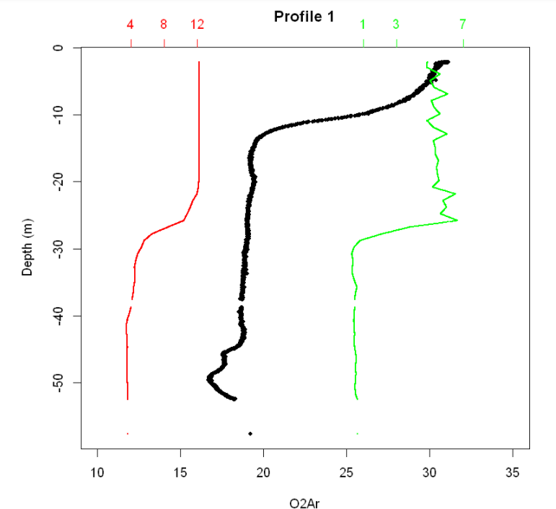
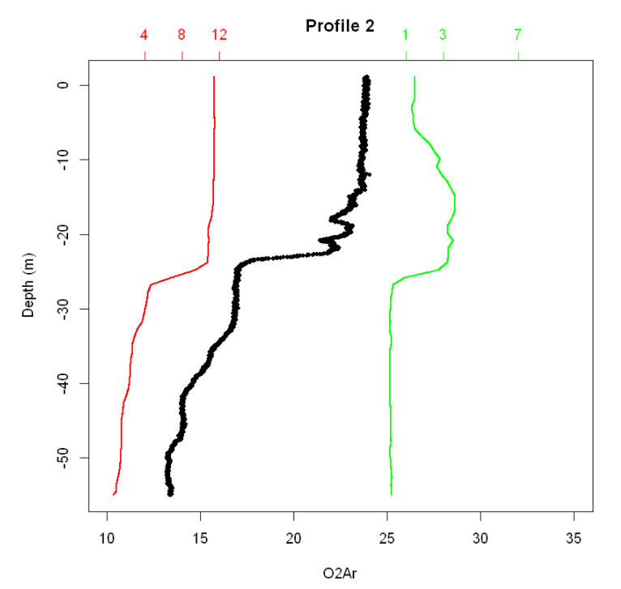
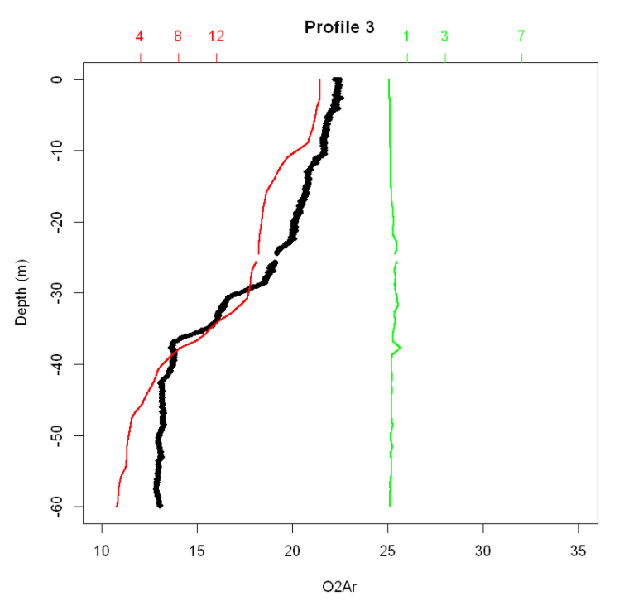
O2/Ar profiles (blck) vs. fluorescence (gr) vs. temp (red)
Cast 23 MLD 23m
Cast 32? MLD 22m
Cast 74 – MLD 12

Slide 22
Further data analysis / comparison (synthesis)
Use CCE-LTER dataset to verify data!
14C (N)PP (24h) in situ from MLD + below (for model) “with constrains”
Bacteria productivity (resp1)- in the mixed layer
Grazing rate (resp2) – in the mixed layer
Chl a
Species
Secondary productivity
Biomass?
Export and new production!
Add data from on-deck incubation (CACLOFI) to constrain PP pattern in the CCE region
use O2 profiles…

Slide 23
FRRF
Available data:
Ek – light saturation
JVPII (mol electrons PSII-1 m-3 d-1) – to be converted to mol C fix
Calculate/plot electron transport for each of the cycles / cruise segments – using P-E analysis and (incident or average) light intensity throughout the mixed layer.

Slide 24
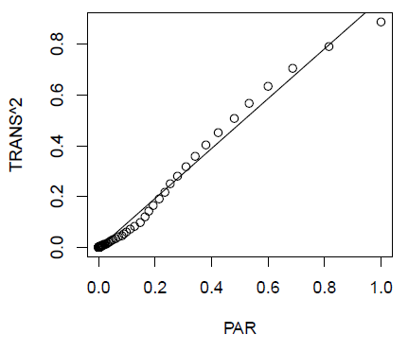
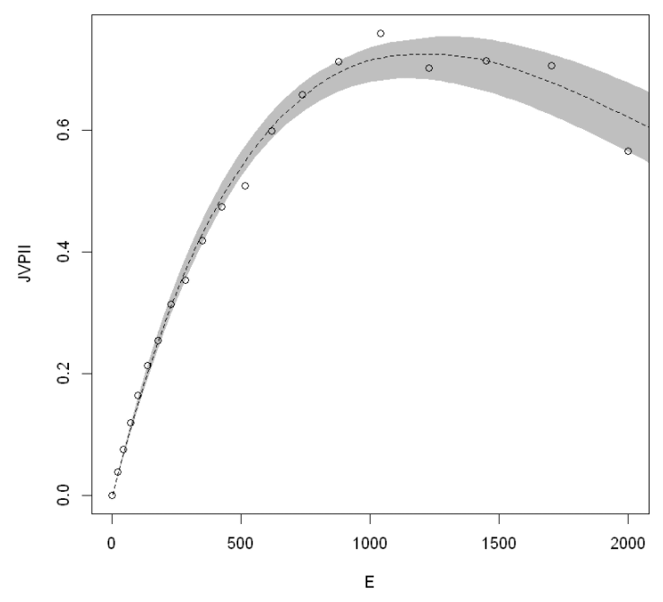
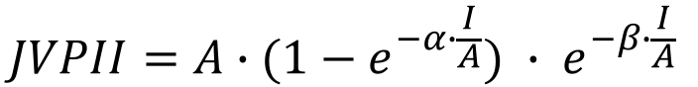
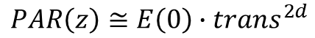
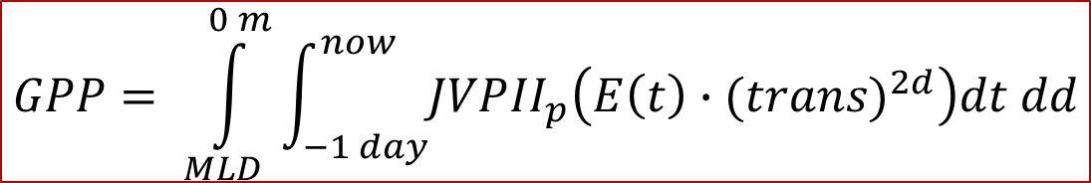
FRRF
PAR
Platt 1980:
$$JVPII=A∙{(1−e}^{−α∙\frac{I}{A}}) ∙ e^{−β∙\frac{I}{A}}$$
Uncertainty Analysis → Jackknife bootstrapping
$$PAR\left(z\right)≅E\left(0\right)∙{trans}^{2d}$$
Surface PAR may be unreliable due to ship’s shadow?
$$GPP= \int_{MLD}^{0 m}{\int_{−1 day}^{now}{JVP{II}_{p}\left(E\left(t\right)∙(trans)^{2d}\right)dt dd}}$$
On going, will have preliminary data soon

Slide 25
Potential projects
SEAVER:
diurnal pattern and correction for vertical structure
Sven:
Diurnal and correction for measurements during transects/SEASOAR and correction for vertical structure using profiles
Synthesis - Using ALL data from CCE : NCP (O2/Ar ) : GP (diurnal MIMS, 14C, FRRF, NO3) – respiration (bacterial, grazing) + diffusion correction from seavers paper?!!
Sven’s 14C C – uptake – using Taylor’s pCO2 / MIMS CO2 data
Tom: Hydrodynamic model

Slide 26
Impact of hydro-dynamics on NCP (Tom’s model)
Use O2 profile data
Use physical model (ROMS model – 40VARS version)
Use O2/Ar profiles

Slide 27
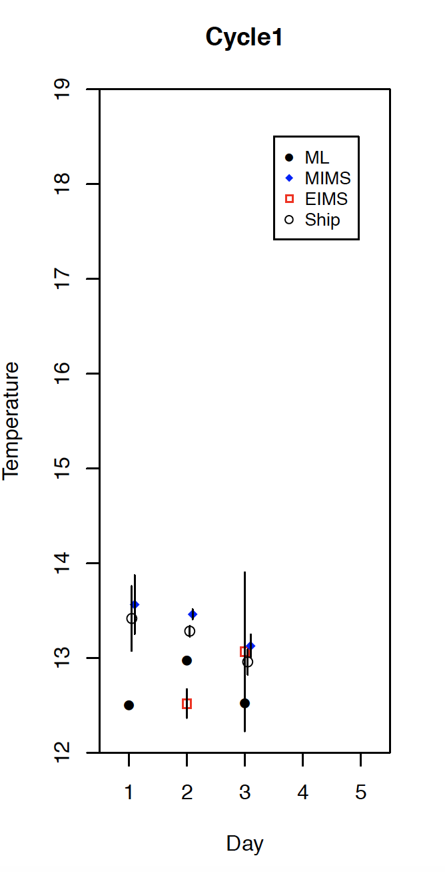
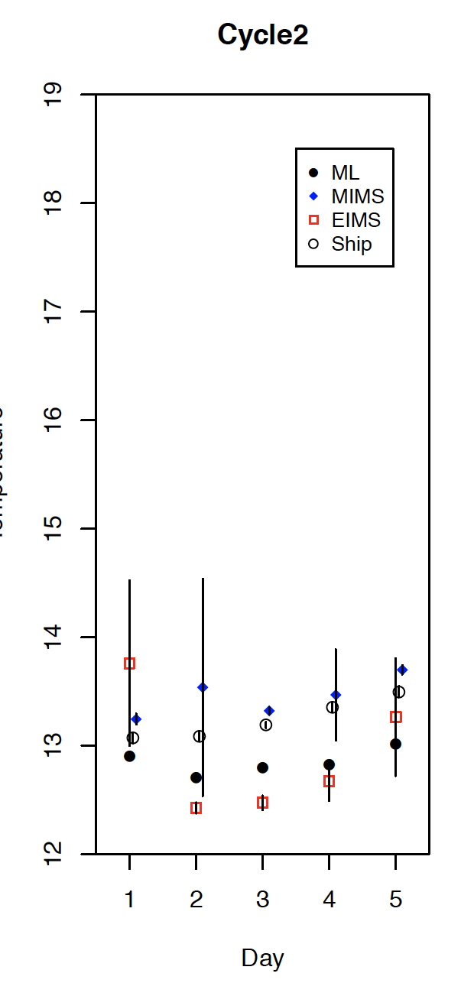
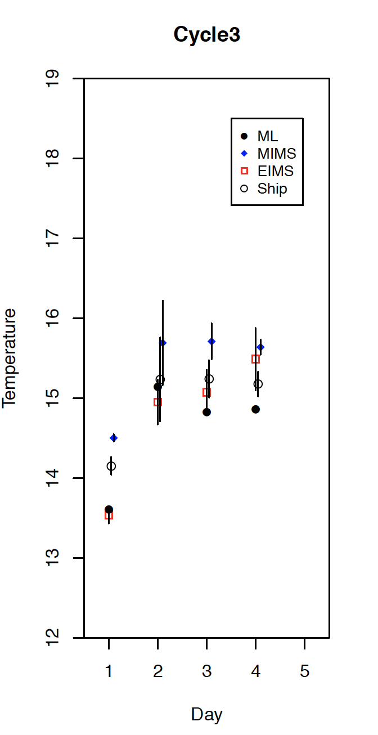
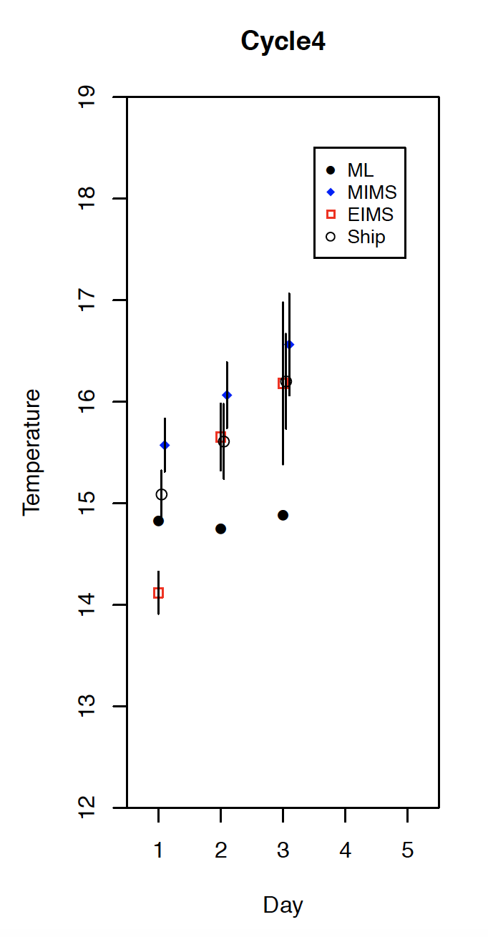
EIMS / MIMS temp sensors inlet vs. ship-data temp
All data fall within 1C difference
Ship and MIMS seem to overlap best!
EIMS seems to have some negative (not consistent) offset
ML: mixed layer average temp
At the moment, the ship thermometer is used for O2 solubility in NCP calc!

Slide 28
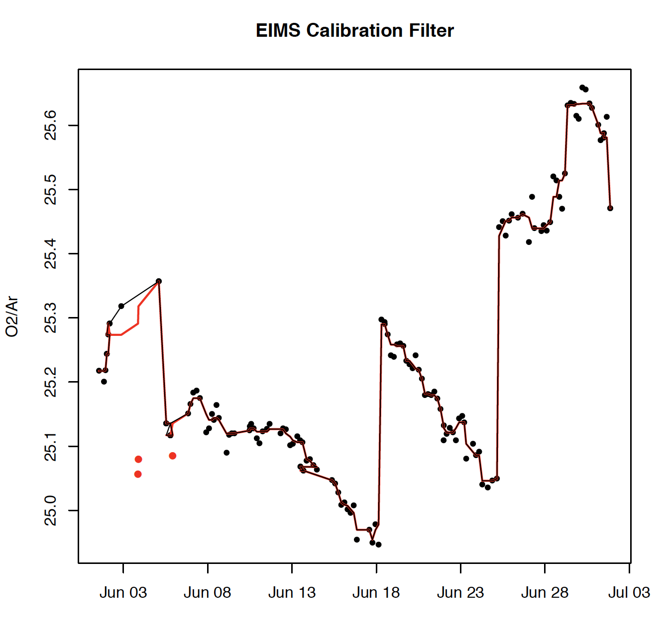
EIMS calibration:
EIMS calibration is very consistent, ranging between 25 to 25.6 .
Offsets happened after EIMS was recalibrated (software recal.)
– Seaver – could you check in the data from the PC when those calibrations where done exactly? – I did not write it down in my lab-book. I need to check for my system, too!

Slide 29
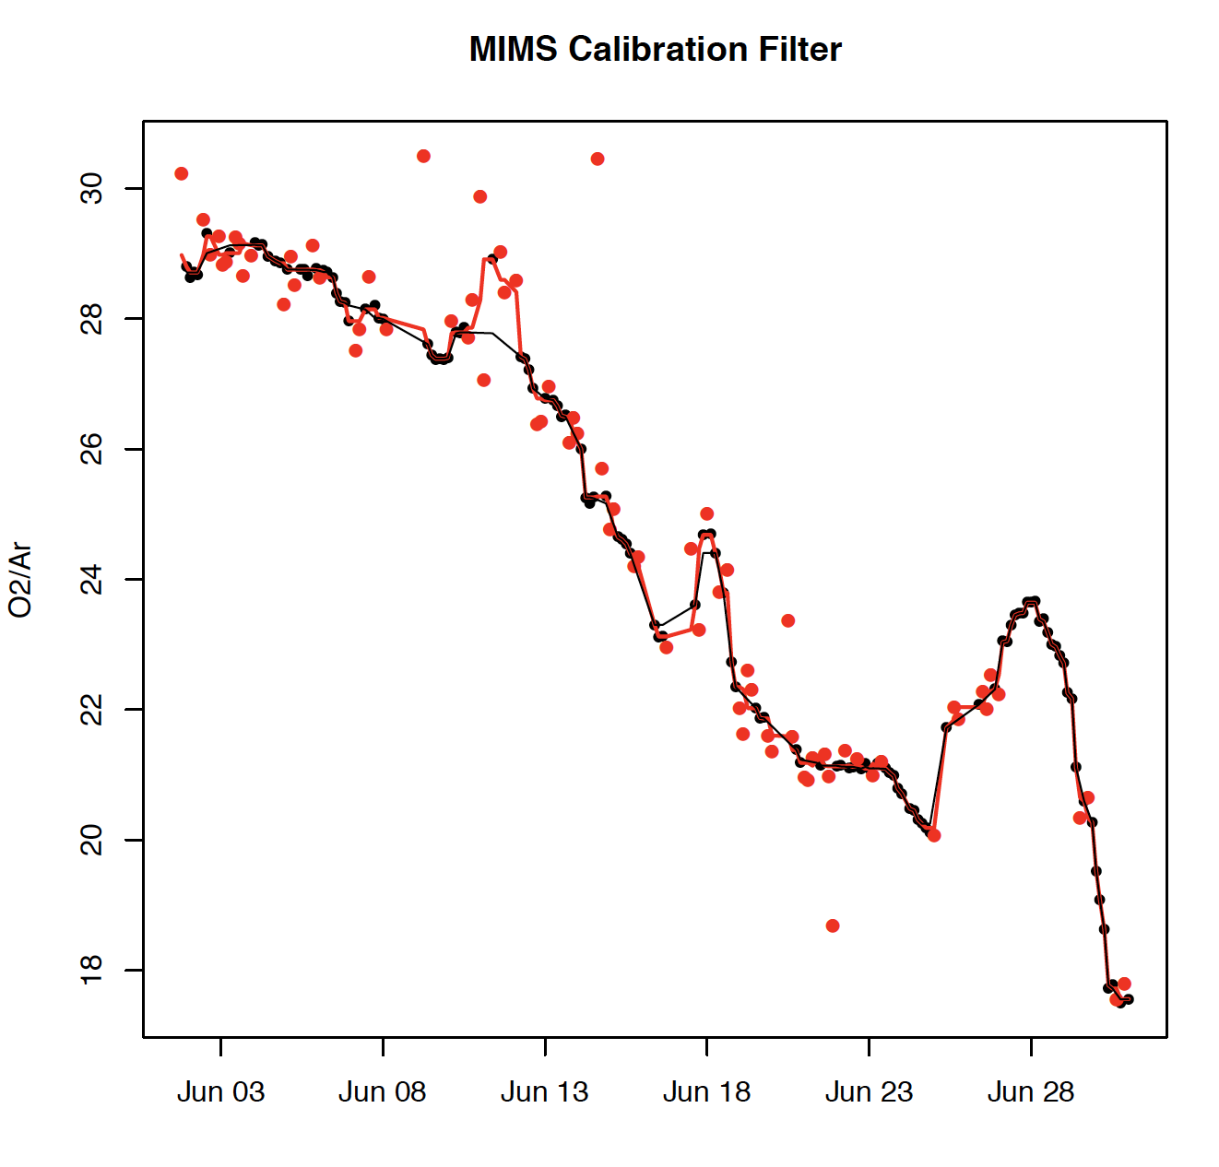
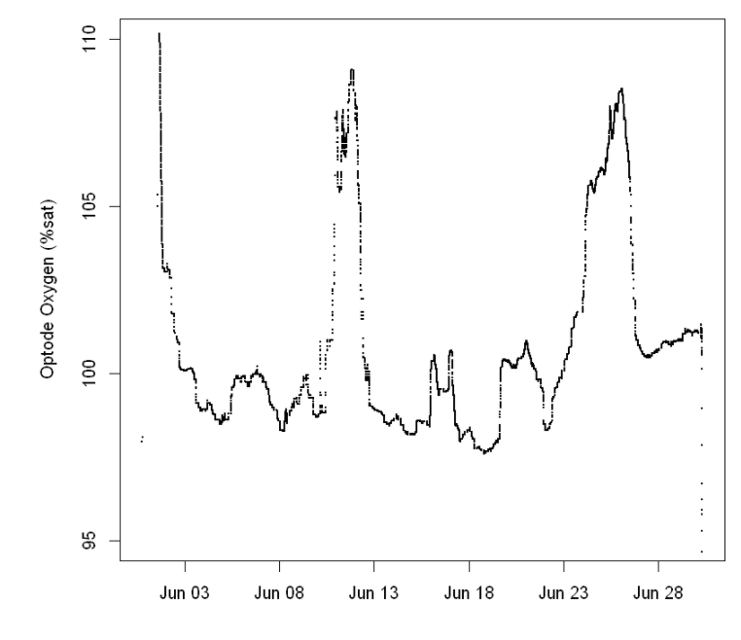
MIMS calibration:
MIMS calibration shows a strong drift!
This is likely due to the change in membrane diffusivity for O2 and Ar and or potentially due to H2O in the system?
Ionization changes? / Calibration?
0.01mm PTFE membrane with 0.5mm PTFE frit.
Changed membrane around June 18 and recalibrated (including offset calc) . Did not change the frit!
O2 conc. in calibration solution was relatively constant, yet did show similar peaks as shown in MIMS O2/Ar!

Slide 30
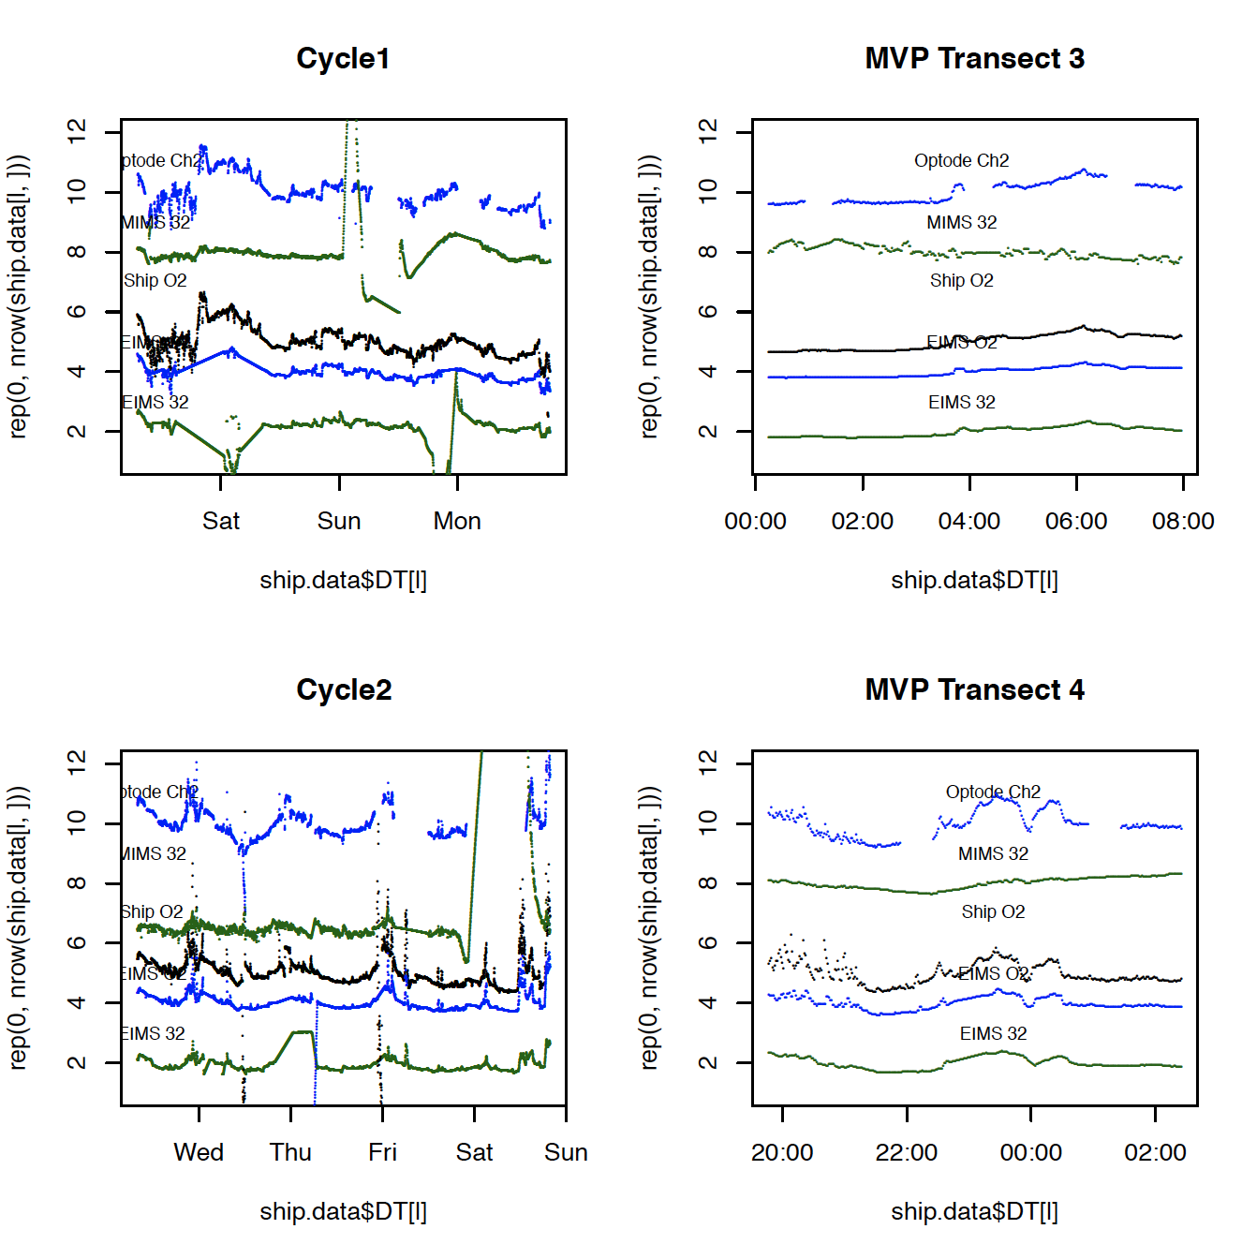
Time-series review

Slide 31
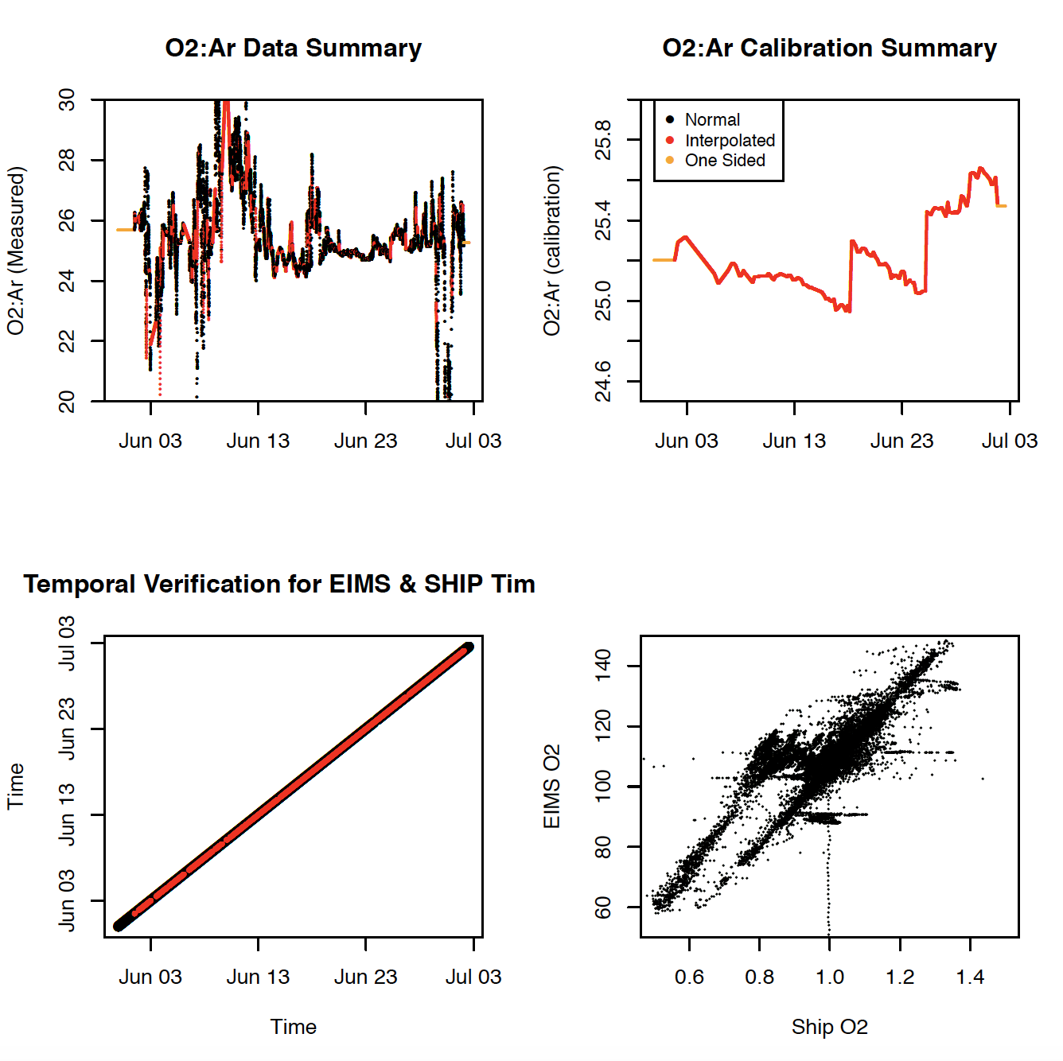
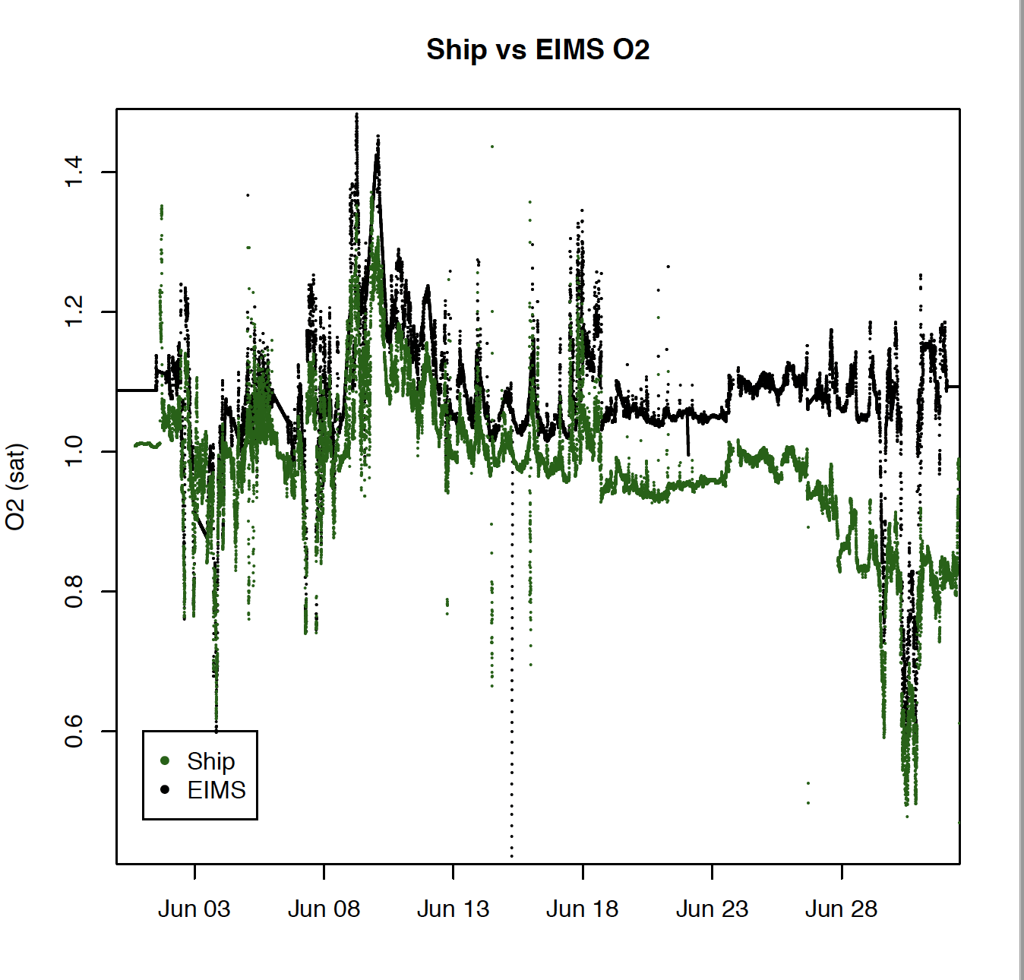
EIMS data
EIMS-O2 data deviate!!!! Why?

Slide 32
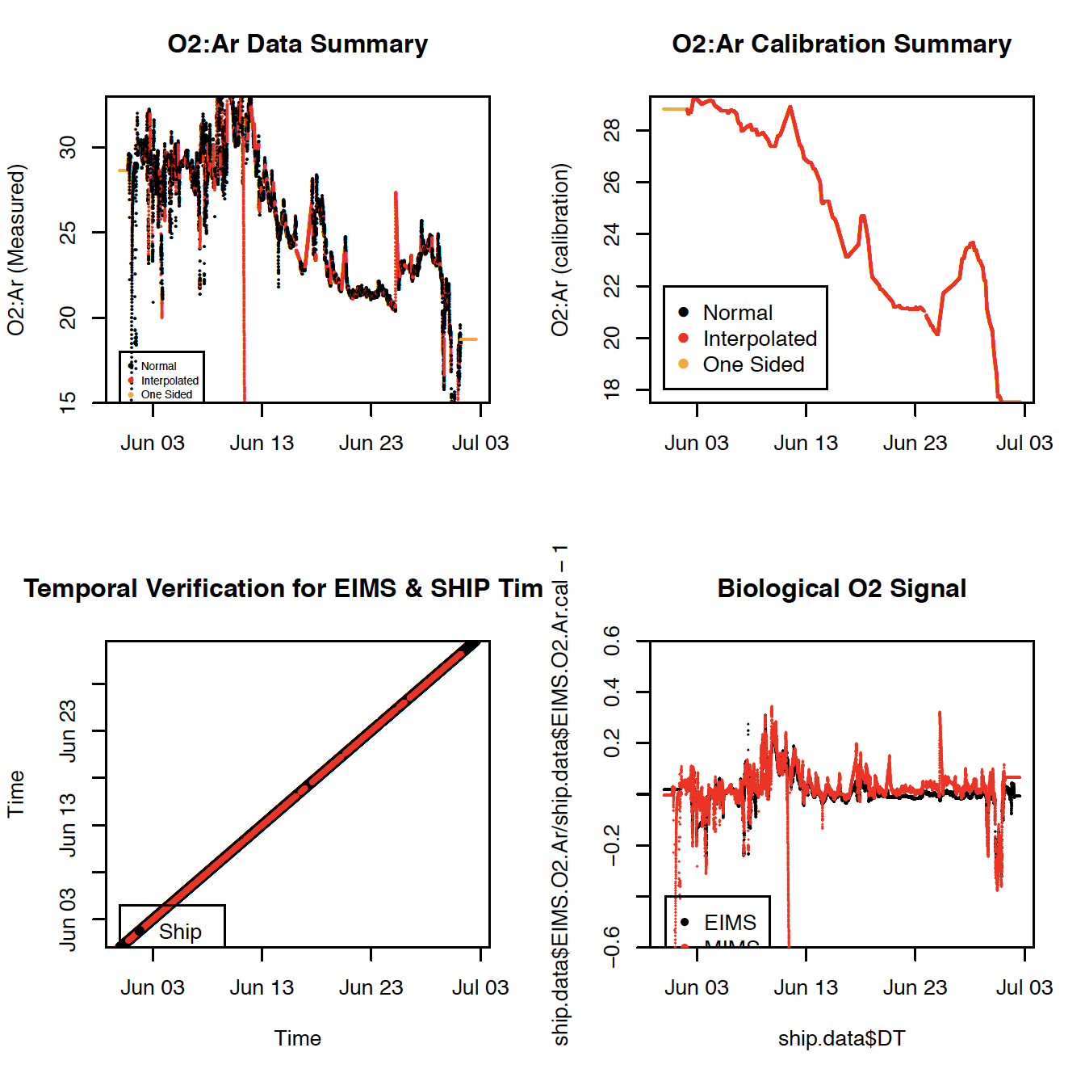
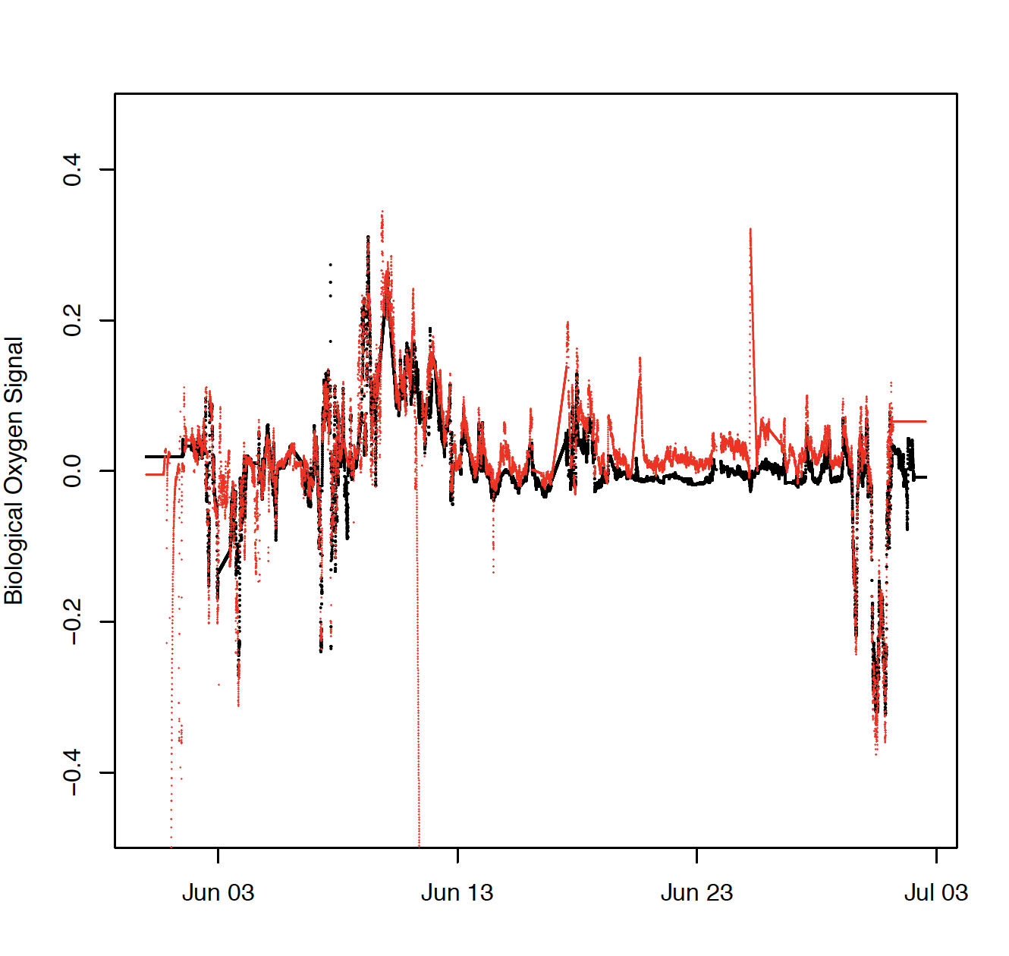
MIMS data

Slide 33
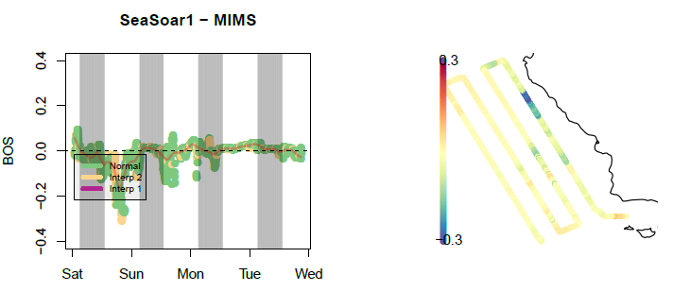
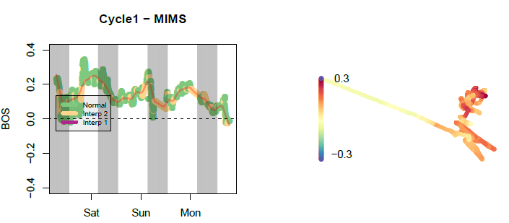
EIMS spatial data
Example EIMS:

Slide 34
P1706 SeaSoar 1: ALFA5 Data on Lat-Long

Slide 35
R-code
https://github.com/tbrycekelly/MIMS-TBK

